Slide 1
Halving and Doubling
Please click on the link below to watch a link:
https://web.microsoftstream.com/video/32cb6ddf-ecc5-4efd-b4eb-f9d6c90bbcf6

Slide 2
Exercise 1a - Halving
Find a half of 64kg
Find a half of 76ml
Find a half of £82
Find a half of 38km
Find a half of £49
Find a half of 95mg

Slide 3
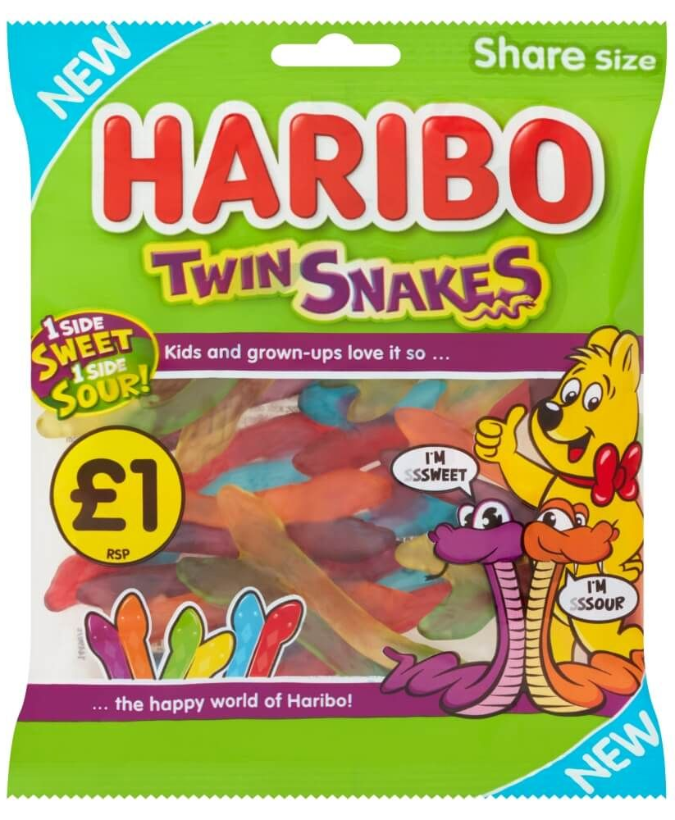
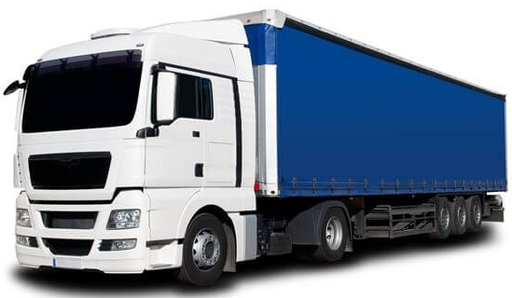
Exercise 1b - Halving
Jane buys a packet of sweets that have a mass of 82g, she eats half of them. What is the mass of the sweets left?
Michael wins £92 in a raffle and shares the winnings equally with his friend Chris, how much will they get each?
A lorry weighs 36 tonne when fully laden, when it is unloaded it is half of its laden weight. How heavy was its load.

Slide 4
Exercise 2a - Doubling
Double £21
Double 37cm
Double 33kg
Double 47g
Double £38
Double 19m

Slide 5
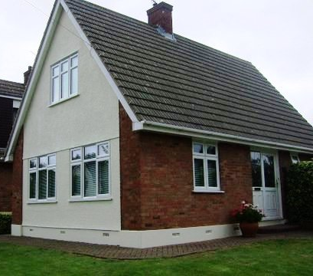
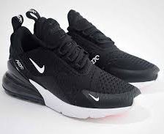
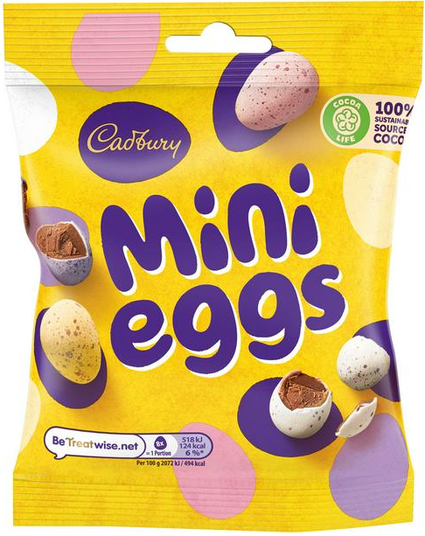
Exercise 2b - Doubling
Amanda works out she needs 29 litres of paint to pint one end of her house, how many litres does she need to paint both ends?
A pair of trainers cost £46, Lucy has twins and needs to buy then a pair each. How much does she end up paying?
John loves mini eggs, he finds out each mini egg has 16 calories, how many calories would 2 mini eggs contain?

Slide 6
Exercise 3
Fill in the blanks to complete the sentences:
If £34 is a half of ___, then £68 is double £34.
If ___ is a half of £76, then £76 is double ___.
If £19 is a half of ___, then ___ is double £19.
If £43 is a half of ___, then ___ is double ___.
If ___is a half of £96, then ___is double ___.
If ___is a half of £37, then ___ is double ___.

