Slide 1


Fractions of amounts
Fractions have a numerator and a denominator:
$$\frac{2}{5}$$
Numerator
(top number)
Denominator
(bottom number)
The denominator tells us how many parts there are in total.
The numerator tells us how many parts we need.

Slide 2
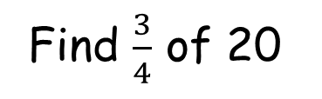
Example
Find $\frac{3}{4}$ of 20
5
5
5
5
20 ÷ 4 = 5
5 + 5 + 5 = 15
or
5 x 3 = 15

Slide 3
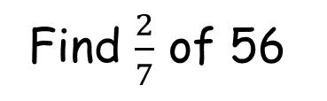
Example
Find $\frac{2}{7}$ of 56
8
8
8
8
8
8
8
56 ÷ 7 = 8
8 + 8 = 16
or
8 x 2 = 16

Slide 4
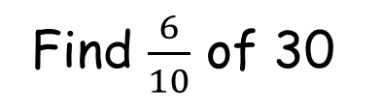
Try this one
Find $\frac{6}{10}$ of 30
3
3
3
3
3
3
3
3
3
3
30 ÷ 10 = 3
3 + 3 + 3 + 3 + 3 + 3 = 18
or
3 x 6 = 18

Slide 5
Exercise
1) 2 of 9 2) 3 of 20
3) 2 of 15 4) 5 of 12
3 of 24 6) 2 of 21
4 of 55 8) 4 of 18
9) 3 of 200 10) 4 of 45
3
4
5
6
8
7
11
9
20
15

Slide 6
Answers
1) 2 of 9 2) 3 of 20
3) 2 of 15 4) 5 of 12
3 of 24 6) 2 of 21
4 of 55 8) 4 of 18
9) 3 of 200 10) 4 of 45
6
15
3
4
6
10
5
6
9
6
8
7
20
8
11
9
30
12
20
15

Slide 7
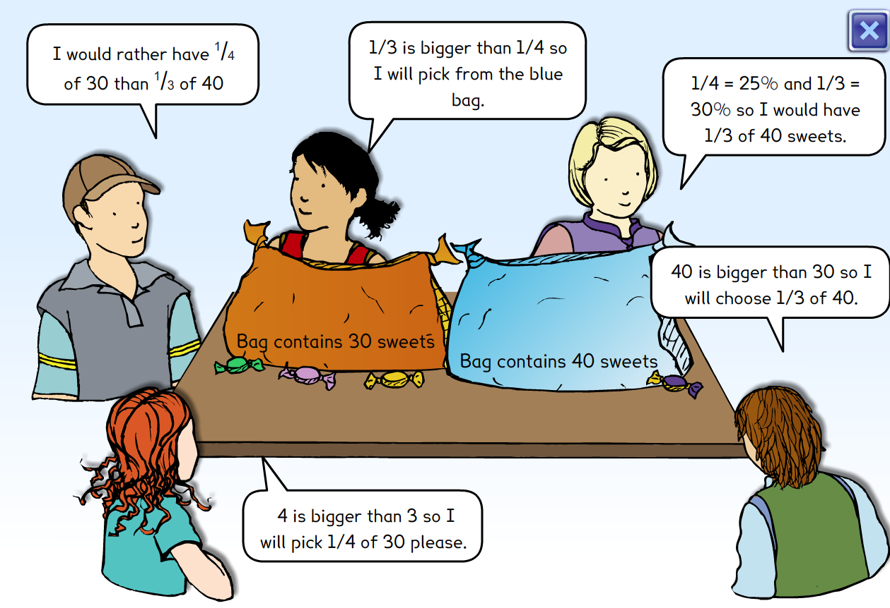
Who is correct?
Notes:
Non calculator – text mark. Organise work. Paired Reading

