Slide 1
Videos
Here are some short videos to show you how to read scales:
(Please copy the links into your web browser to access the videos).
Measuring with a ruler:
https://web.microsoftstream.com/video/9ccefad0-459e-432d-84c2-cb9919434846
Using weighing scales:
https://web.microsoftstream.com/video/c55ddb8d-dbaa-4751-80af-aaa10739f78f
Measuring jug scales:
https://web.microsoftstream.com/video/8b42369e-f80a-494a-a869-c5622c971dc4

Slide 2
Length Measurement Quiz
Please click on the link below or copy this link into your web browser:
https://wordwall.net/resource/32584/length

Slide 3
Length Vocabulary Wordsearch
Please click on the link below or copy this link into your web browser:
https://wordwall.net/resource/15954533/length-vocabulary

Slide 4
Estimating Length Match up game
Please click on the link below or copy this link into your web browser:
https://wordwall.net/resource/44351/maths/estimating-length-match-up-game

Slide 5
Weight Quiz
Please click on the link below or copy this link into your web browser:
https://wordwall.net/resource/230203/quiz-about-weight

Slide 6
Measurement Sort Activity
Please click on the link below or copy this link into your web browser:
https://wordwall.net/resource/45483/maths/sort-measures-weight-capacity

Slide 7
Measurement Matching Pairs Activity
Please click on the link below or copy this link into your web browser:
https://wordwall.net/resource/60897/maths/matching-pairs-weight-length-capacity

Slide 8
Reading Scales Activity 1
Please click on the link below or copy this link into your web browser:
https://www.transum.org/Maths/Activity/Reading_Scales/

Slide 9
Reading Scales Activity 2
Please click on the link below or copy this link into your web browser:
https://www.transum.org/Maths/Activity/Reading_Scales/Default.asp?Level=3

Slide 10
Reading Scales Activity 3
Please click on the link below or copy this link into your web browser:
https://www.transum.org/Maths/Activity/Reading_Scales/Default.asp?Level=5

Slide 11
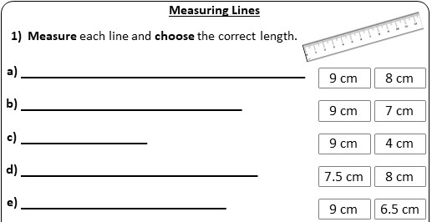
Measuring Lines Task

Slide 12
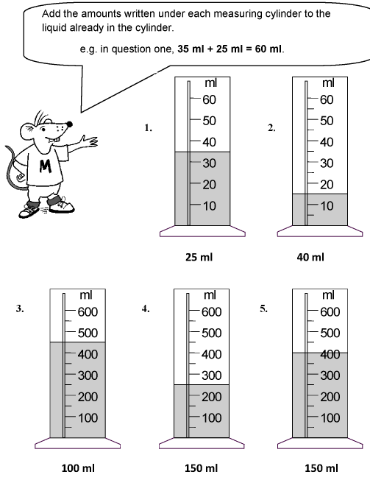
Reading Scales Task

