Slide 1
2-Digit by 1-Digit Multiplication
Prior Knowledge Check
Evaluate:
10 x 7 =
3 x 9 =
5 x 8 =
6 x 2 =
7 x 4 =
Work out
1) 3 x 90 =
2) 6 x 70
3) 2 x 80
4) 60 x 4
5) 80 x 5
What does:
The 8 in 82 represent?
The 4 in 47 represent?
The 9in 987 represent?
The 3 in 263 represent?
The 5 in 5283 represent?

Slide 2
2-Digit by 1-Digit Multiplication
Prior Knowledge Check
Evaluate:
10 x 7 = 70
3 x 9 = 27
5 x 8 = 40
6 x 2 = 12
7 x 4 = 28
Work out
1) 3 x 90 = 270
2) 6 x 70 = 420
3) 2 x 80 = 160
4) 60 x 4 = 240
5) 80 x 5 = 400
What does:
The 8 in 82 represent?
80
The 4 in 47 represent?
40
The 9in 987 represent?
900
The 3 in 263 represent?
3
The 5 in 5283 represent?
5000

Slide 3
2-Digit by 1-Digit Multiplication
Example 1
Example 2
54 x 7 =
8 x 36 =

Slide 4
2-Digit by 1-Digit Multiplication
Examples
Now Try These
54 x 7 =
19 x 3
28 x 5
72 x 4
96 x 8
34 x 9
8 x 36 =

Slide 5
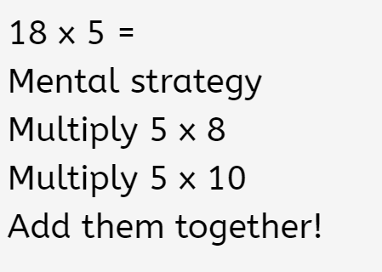
The same method can also be applied as a mental strategy…
40
50
90

Slide 6
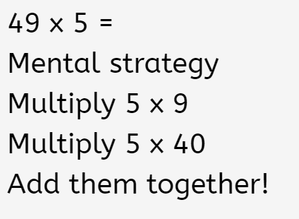
Try these…

Slide 7
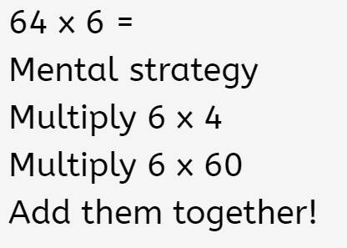

Slide 8
Activities

Slide 9
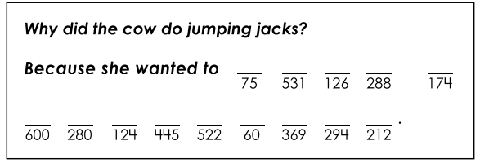
The Exercising Cow
Solve the riddle below by matching the letters of each question to the blank lines below.
A 29 x 6 =
E 32 x 9 =
K 98 x 3 =
M 15 x 5 =
I 70 x 4 =
E 53 x 4 =
L 62 x 2 =
K 89 x 5 =
A 41 x 9 =
K 18 x 7 =
S 87 x 6 =
M 75 x 8 =
H 20 x 3 =
A 59 x 9 =

Slide 10
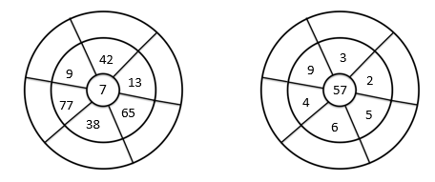
Multiplication Wheels
Multiply the number in the centre with each of the surrounding numbers, putting your answers in to the outer circle.

Slide 11
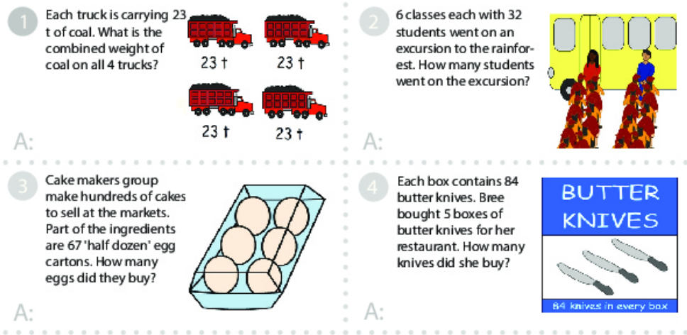
Worded Problems

Slide 12
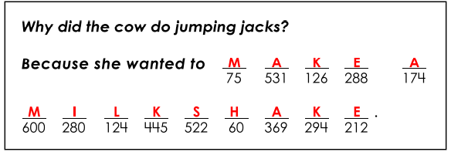
Answers
Worded Problems
4 x 23 = 92t
6 x 32 = 192 students
6 x 67 = 402 eggs
5 x 84 = 420 butter knives

Slide 13
Further Practice Online
Math Game: Multiply 2-Digit by 1-Digit Numbers (iknowit.com)
Multiplication - 2 Digits by 1 Digit | Math Playground
One-Digit by Two-Digit Multiplication Basketball Game for Tablets and iPads (math-play.com)

