Slide 1
The presentation has suggested activities for you to complete at home, either with a parent or carer or individually.
Pentrehafod
School Mathematics Department

Slide 6
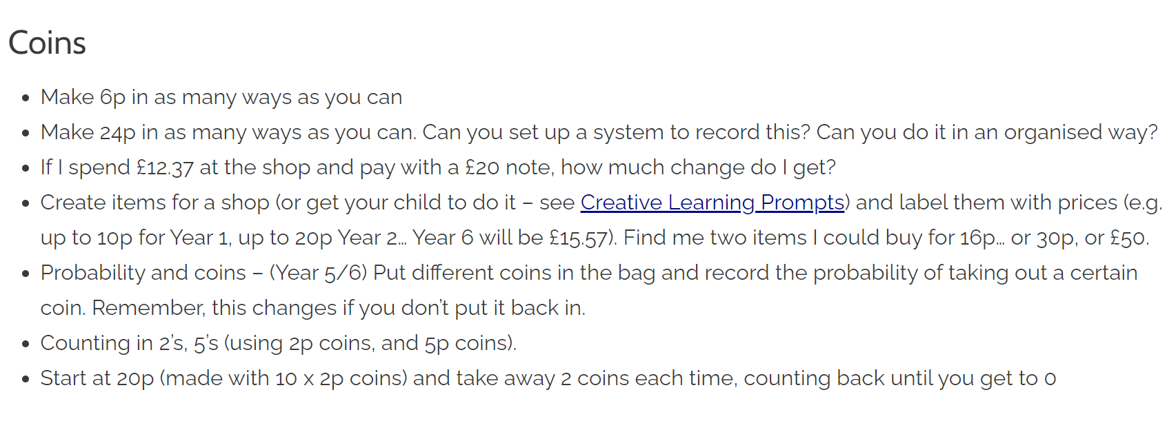

Slide 7
Suggest web sites
Play Chess Online, Learn Chess & Practice Online | Kid Chess ®
Minus Miners | Mangahigh.com
Interactivate: Equivalent Fractions Finder (shodor.org)
Factor Pair Up | Math Playground

Slide 8
Book Suggestions
Mansa's little Reminders: Scratching the surface of financial literacy: Amazon.co.uk: Williams, A.D., Fordham, Kendal, Bou, Taylor: Books
Dosh: How to Earn It, Save It, Spend It, Grow It, Give It: Amazon.co.uk: Sirdeshpande, Rashmi, Hayes, Adam: Books
10 Minutes A Day Fractions, Ages 7-11 (Key Stage 2): Supports the National Curriculum, Helps Develop Strong Maths Skills (Made Easy Workbooks): Amazon.co.uk: Vorderman, Carol: 9780241182321: Books
I Want More Pizza: Real World Money Skills For High School, College, And Beyond: Burkholder, Steve, Maizel, Rebecca, Aretha, David: 9780996519403: Amazon.com: Books
Millions: Amazon.co.uk: Cottrell Boyce, Frank, Lenton, Steven: Books
Maths Games for Clever Kids® Buster Brain Games, 5: Amazon.co.uk: Moore, Gareth, Dickason, Chris: Books

Slide 9
Suggested games to purchase
Wildcard Games Arithmanix The Ultimate Number Game The Game Of Rapid Calculation: Amazon.co.uk: Toys & Games
BrainBox Maths Plus: Amazon.co.uk: Toys & Games
Time and Money (Brighter Child Flash Cards): Amazon.co.uk: Brighter Child: Books
Learning Resources Sum Swamp Addition & Subtraction Game: Amazon.co.uk: Toys & Games
Toyrific Kids Magnetic Dartboard Set with 6 Magnet Darts: Amazon.co.uk: Toys & Games

