Slide 1
Subtraction
Please click on the link below to watch a link:
https://web.microsoftstream.com/video/df5016c8-ced4-4457-92b1-07a68bb7c076

Slide 2
Subtraction Practice
1)
8
6
4
2)
9
6
5
3)
7
4
3
–
5
3
2
–
8
0
4
–
4
2
5
4)
7
3
6
5)
5
3
3
6)
9
1
0
–
3
7
0
–
3
6
7
–
1
9
8

Slide 3
Subtraction Practice
Fill in the blanks to complete the following subtractions.
1)
7
3
2)
6
1
3)
6
–
2
2
–
2
–
7
4
9
3
1
5
1
2
1
2
1
5
4)
8
9
5)
6
7
6)
4
7
–
5
8
1
–
6
9
–
3
9
5
1
5
8
5
3
8

Slide 4
Subtraction Practice
Subtract the following and check using addition.
1)
8
2
6
2)
7
3
7
3)
6
8
1
–
5
3
2
–
6
0
9
–
2
9
7
+
5
3
2
+
6
0
9
+
2
9
7

Slide 5
Subtraction Practice
Subtract the following and check using addition.
4)
3
1
7
5)
8
0
4
6)
5
5
6
–
2
4
8
–
6
6
7
–
2
8
9
+
2
4
8
+
6
6
7
+
2
8
9

Slide 6
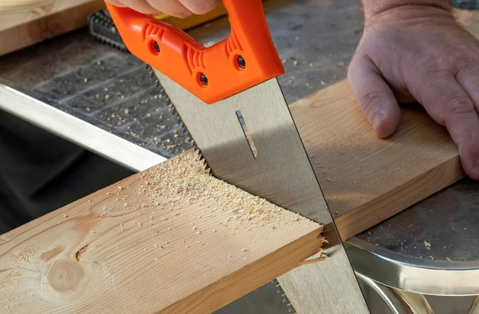
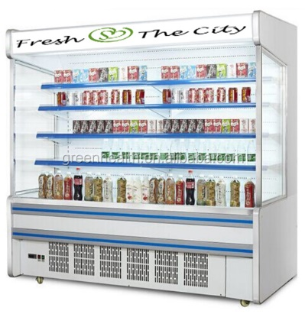
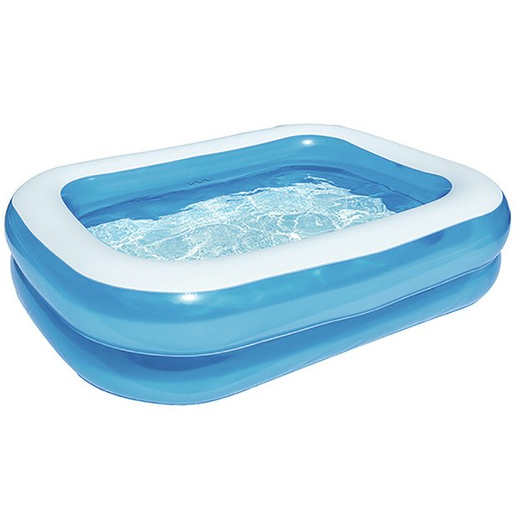
Subtraction Practice – Problem Solving
A length of wood is 356cm and a piece measuring 382cm is cut off, how much wood is left?
A shop owner has space for 432 cans of pop in the fridge is his shop. In one week he sells 189 cans, how many cans would he need to buy the following week to restock his fridge?
A paddling pool holds 960 litres of water. The pool is damaged and 273 litres of water leak out during the night. The owner repairs the pool in the morning. How much water is left in the pool?

Slide 7
Subtraction – Links to websites
https://corbettmaths.com/wp-content/uploads/2018/09/Subtraction-pdf.pdf
https://corbettmaths.com/wp-content/uploads/2013/02/subtraction-pdf.pdf
https://www.bbc.co.uk/bitesize/topics/zy2mn39/articles/zc78srd

